Slide 1
Useful Technology in the Courtroom
Carrie L. Batalon CBatalon@lawmg.com www.LawMG.com | Nicholas A. Shertzer Nick@NickShertzer.com www.NASTechLLC.com

Slide 2
Carrie Batalon
Partner Mallor | Grodner LLP
Certified Family Law Specialist, by the Family Law Certification Board
Carrie’s primary area of practice is family law, including divorce, child custody and support issues, adoptions, guardianships and paternity matters. She is a Registered Family Law Mediator and also practices in business and civil litigation and landlord/tenant law.

Slide 3
Nicholas Shertzer
IT Systems Administrator at Mallor Grodner LLP since 2004
Owner NAS Technology Consulting, LLC
Nick received an associates in computer science from Ivy Tech in 2004 with a focus on networking. NAS Technology specializes in small to medium law firms in the southern Indiana area. Mallor Grodner moved to the “cloud” in 2014, moving towards a paperless office by using Clio and Google G Suite for Business.

Slide 4
Useful Technology in the Courtroom

Slide 5
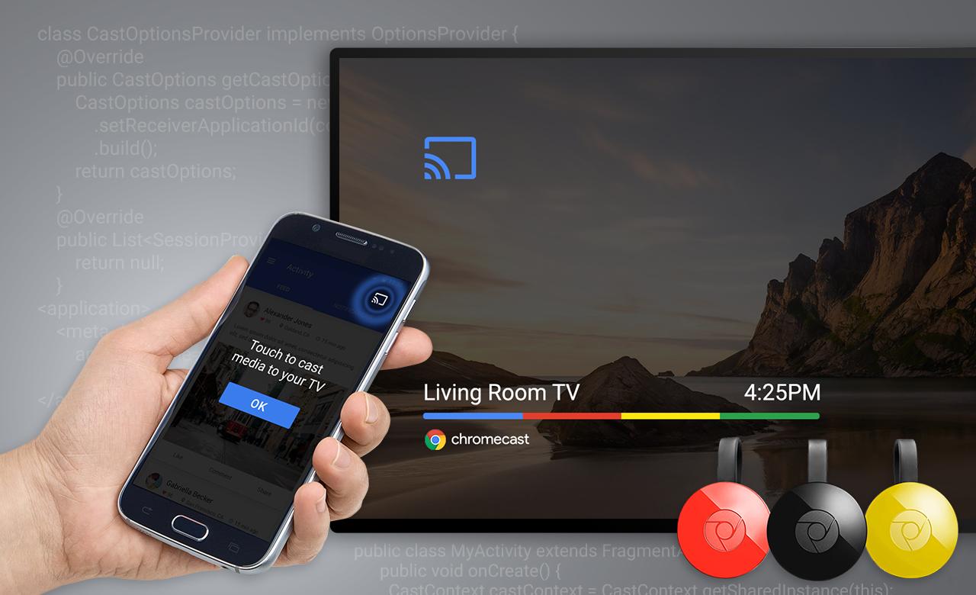
Wirelessly Cast Video
Cast your phone wirelessly to any device with HDMI
Android + Chrome Cast + WiFi
iPhone + AppleTV + WiFi
Windows 10 + Microsoft Wireless Adapter (direct connection)

Slide 6
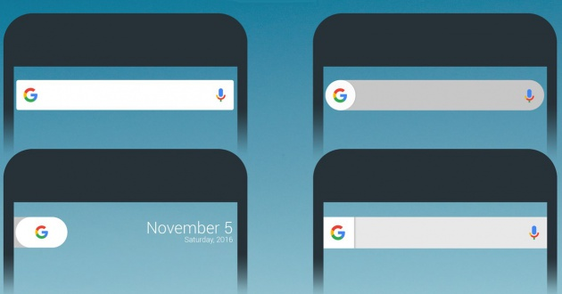
Search
Search can pull up messages, emails, calls, and other details more rapidly than just fumbling through your phone's apps
Search is a great way to find rarely used settings
Search is integrated into Apple’s Siri and Android’s Google Assistant
Discover over 1 million things Google Assistant can do at https://assistant.google.com
Learn more things you can do when you say “Hey Siri” at https://goo.gl/zHMiYr

Slide 7
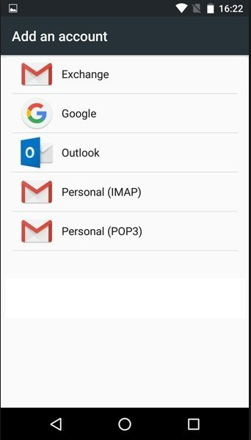
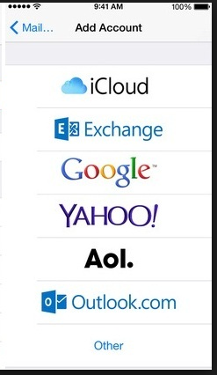
Mobile Email
POP
IMAP
Exchange
Office 365 Hosted Exchange
Google G Suite for Business
Notes:
Mobile email.
Arguably, having email on our phones is what lead to the rise of the modern smartphone. Hopefully we all already have email configured on our phones. But, there are some tips to make sure we are getting the most out of our setup.
How we configure mobile email is important. Older technologies such as POP mail should be avoided. The reason is that when configured as POP, messages are removed from the email server and stored only on the local device. In the old days of only checking your email on one machine, this was OK. Now, however, we check our email on multiple devices, in multiple locations. Do not use POP.
IMAP is a little better. IMAP was developed to fix some of POP’s problems. Messages are left on the server and can be marked as read from one device, such as our phone, and that read status will appear on our desktop email, such as Outlook. But, with that said, do not use IMAP.
The best way to configure our smartphones for email is by using an email sync service such as Google G Suite for Business or Microsoft Hosted Exchange. These services provide a synchronization technology that allows us to access:
Incredibly huge mailboxes, in some cases unlimited.
Access to saved folders – not just the inbox
Calendar sync’d to the web and therefore our desktop computer
Contacts also sync’d to the web.
If you already have an Exchange server in your office, then you can use Outlook Web Access or OWA technology to set up mobile Exchange.
This brings up an important distinction when it comes to email. Using a free email service such as Gmail or Outlook.com will get us many of these same sync technologies. However, free email services come with large caveats that make them impractical for use in the legal setting. The largest of these concerns is privacy. The adage that applies here is: when you are not paying for it, you are the product. Free email services will scan your inbox, using full text searching to show relevant ads to you while you use their service. This becomes a problem when considering a lawyer’s client / attorney privilege.
Google G Suite for Business and Microsoft Hosted Exchange both offer a Business Associate Agreement or BAA. Signing a BAA with Google certifies Mallor Grodner to store and transmit Protected Health Information within the requirements of HIPAA. Using Google G Suite for Business with Mallor Grodner also certifies that all our communication and storage data is safe and secure with leading industry security standards such as ISO 27001 certifications and SOC2 and SOC3 Type II audits.

Slide 8
Business Associate Agreement
Sign a BAA with a cloud service provider to assure compliance
Make sure the cloud service provider is certified to transmit and store HIPAA
The responsibility for security of data is offset onto the cloud provider
Leading industry security standards include ISO 27001 certification and SOC2 and SOC3 Type II audits

Slide 9
Mobile Calendar
Choose a cloud-based bi-directional sync
01
Set a default calendar when syncing multiple accounts
02
Be aware of the Event owner when creating entries
03
Notes:
Mobile Calendar
Because Google G Suite is again a synchronization service, it also syncs our calendar to the web and our cloud-based practice management software Clio.
Having our shared calendar on my phone allows me to quickly check my schedule and even add appointments while in the courtroom. It is important that our calendars also interface with our practice management system for malpractice insurance requirements. This should be a bi-directional sync; add an entry to either your practice management software or your phone and it shows up in the other. Some practice management software only syncs your calendar when you specifically run a process telling the calendars to sync. This is OK, if you or your staff remember to “push the button” to sync on a regular basis.
A better method used by Clio for Outlook is an “auto synchronization” program that automatically syncs your calendar on a schedule of your choosing. However, this still has the drawback that your desktop computer must be on AND the auto sync program has to be running in order to keep your calendar current. If my computer restarts because of a Windows Update, that application will not run until I log back on to my computer. This means I may not have the most up to date calendar when I need it the most.
The best method is to use a cloud or server-based sync method that is always up to date. Clio Sync for Google is one such example that we use at Mallor Grodner. The Clio Sync for Google works as a “Cloud to Cloud” service, meaning I never have to manually push a sync button, I never have to make sure a program is still running on my computer or that my computer in the office may be off or sleeping.
The way this works is sort of like magic, but it is incredible helpful to know I always have the most up to date calendar on my phone.
One important thing to note is that I have multiple accounts on my phone that all sync a calendar. I have my work account and a personal Gmail account. Some of you may have Office 365, Exchange, iCloud, Yahoo, or Outlook.com accounts already configured together on your phone. Each of these accounts sync their own calendars to your phone, which are then cleverly shown together as a sort of merged calendar. When you create an appointment, look at the Event “owner” and make sure you are creating appointments on the appropriate calendar! Failure to do so may lead to your paralegal seeing that your dog has a vet appointment on Thursday but missing out on that important scheduled mediation.

Slide 10
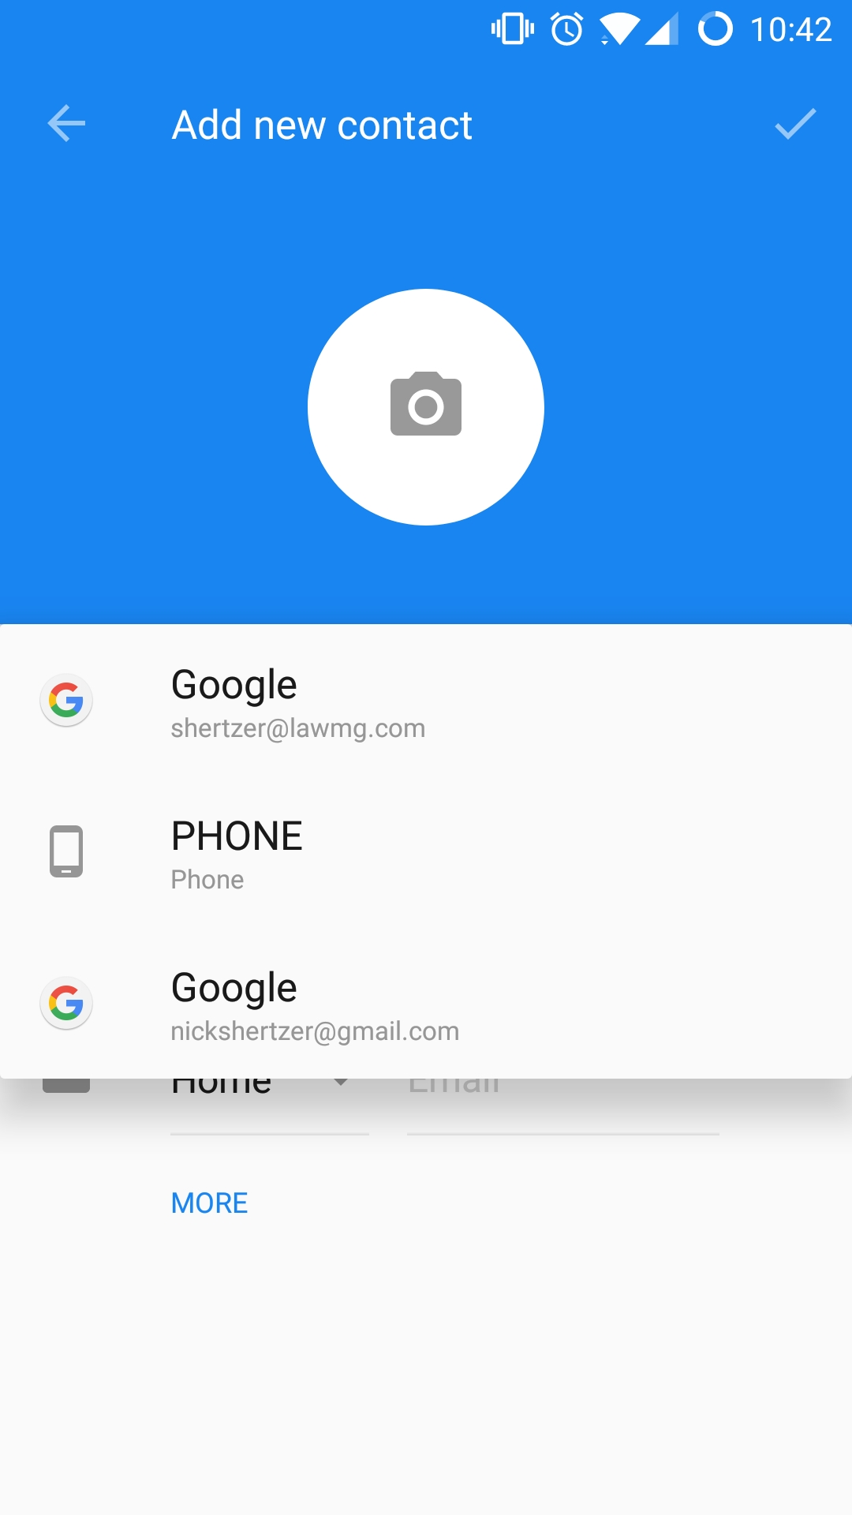
Mobile Contacts
Multiple accounts can sync to the cloud but they all show up in one list.
Choose a default and stick with it!
Do not choose “Phone”!
Notes:
3. Mobile Contacts
The contact list on my phone works much like the calendar. Multiple accounts sync to the cloud. Personal contacts sync to iCloud or Gmail. Company contacts sync to Exchange or G Suite. It is important to know the different types of accounts on my phone to separate data and verify that contacts are backed up.
Much like creating an event in my phone’s calendar, creating a contact also has an account associated with it. In this example, you can see that there is a choice called “Saving To:” that lists multiple different accounts. The option of Phone and SIM card lock that contact record to this phone. If I wanted to save this contact record and see it in on my desktop, I would choose my business email lawmg.com account. Because Mallor Grodner uses G Suite for Business, now that contact will be saved to the cloud and I can see it on my desktop PC in Outlook or on the web at contacts.google.com. If my phone is lost or stolen, adding my lawmg.com account to a new phone restores all my contacts, emails, and calendar entries with nothing lost.

Slide 11
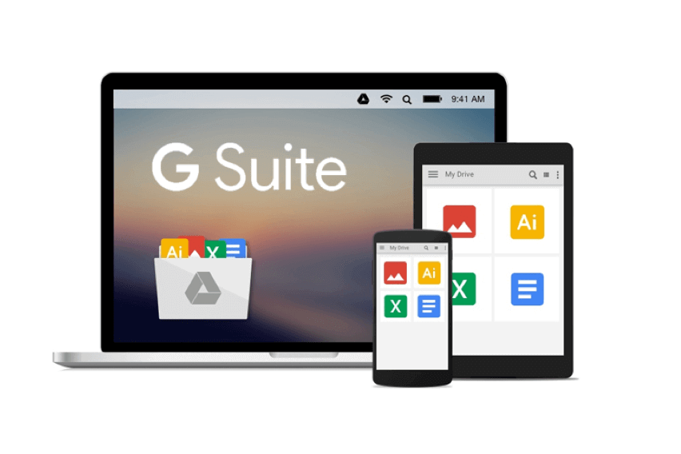
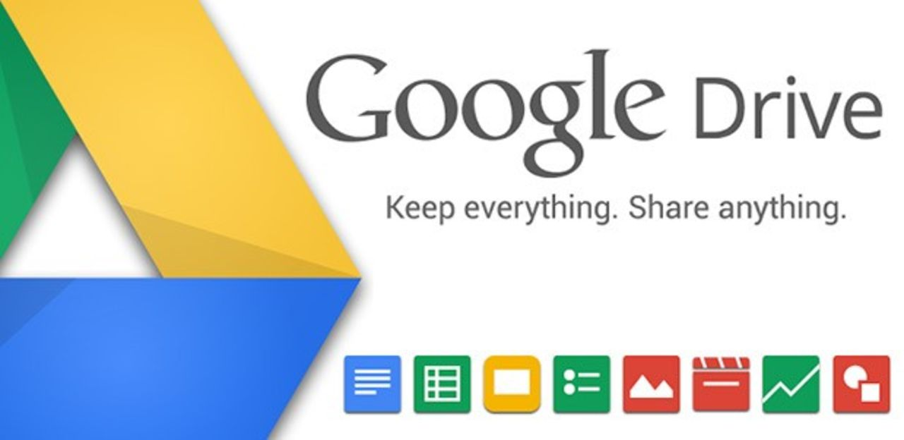
Access our Client Files
See and edit every document
Use folder navigation or Search
Full text search of files contents
Unlimited storage
Share any size file as a link instead of email attachment
Other Cloud services include One Drive, Dropbox, and BOX
Notes:
Access Our Client Files
At MG, our client files, PDFs, Word Docs, Excel spreadsheets, are no longer locked to our office. In fact, they are no longer locked to desktop computers. Because we have moved our office to Google, our client files live inside Google Drive. Many of the same features discussed are also available on competing cloud services, such as Office 365 One Drive, Dropbox, and BOX.
Google Drive has an app available in the Android play store and the iOS app store. This app lets us see and even edit every document we have in our client directory. The app can be navigated using familiar folder structure, point and clicking. But because the product is made by Google, search is where Google Drive really shines above all the competitors. I can just type in a client’s name or their matter number, and their folder appears in moments.
Search is also much more powerful than an indexed Windows or Mac search. Google does a full text search of all our documents. This is not just limited to file and folder names. A search in Google Drive includes every file that search appears inside.
This app is also available for tablets such as the iPad or Samsung Galaxy Tab. The larger screen of these devices makes it possible to review documents on the go. Because MG scans all our incoming mail to our Google Drive, attorneys can and do review their mail from anywhere using this. It is also useful in meetings to be able to review documents in a format roughly the size of a pad of paper with our clients.
Google Drive is also available as a web page which technically makes it possible to use any device with a web browser.
Google Drive also allows us to share any file of any size. Email attachments typically have a limit of 10 to 20 megabytes. Files shared via Google Drive are securely locked behind a username and password of a Gmail or Google associated account. We can also choose to share entire folders if needed.
But that is not all Google Drive can do

Slide 12
Scan a PDF with Google Drive
Open the Google Drive app Google Drive.
In the bottom right, tap Add
Tap Scan .
Take a photo of the document you'd like to scan.
Adjust scan area: Tap Crop
Take photo again: Tap Re-scan current page
Scan another page: Tap Add
To save the finished document, tap Done
Notes:
5. Scan a PDF with Google Drive
Google Drive has a feature to scan a document to PDF using our cell phone’s camera! Just tap the add plus button in the bottom corner of the screen and choose Scan. The scanning options are basic, but include crop, rotate, color settings, and add page. This is perfect for scanning a page in a pinch. Results are often quite good, depending on a steady hand.

Slide 13
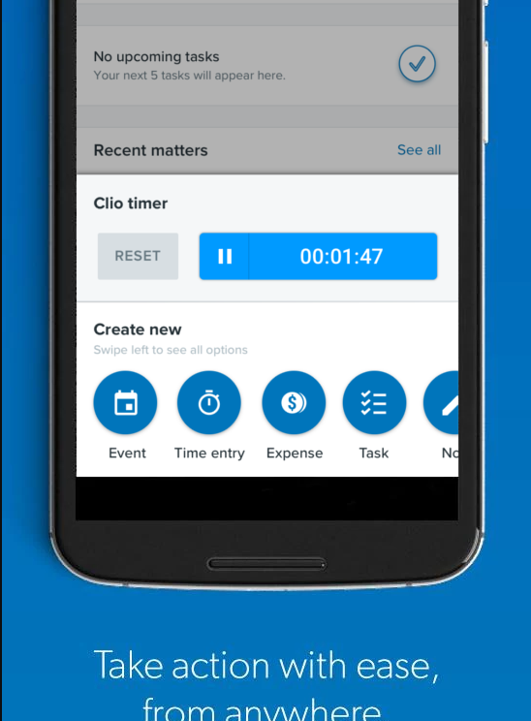
Bill Time With Clio
Track time and expenses on the go
Access your matters and associated information
Keep on top of your tasks on the go
View and reach your contacts
Access and modify your calendar
Other cloud time keeping apps includes Toggl
Notes:
6. Bill Time
Google G Suite is the tool that Mallor Grodner uses to help us work efficiently from any location on any device. But our cloud based practice management software called Clio is the glue that holds it all together.
With Clio, we can manage every detail of every case from a single dashboard. It links every contact, event, task, communication, and time entry to the appropriate matter—and add notes at any time. Organize all text, audio, and visual files for each case with unlimited document storage.
Clio offers integrations with over 72 cloud services providers such as Google, Microsoft, Vonage, Logikcull, FastCase and many more. Clio also has an open API that works with Zapier to bring even more functionality in an “If this, than that” format.
Clio’s timekeeper lets us track time spent on a case, no matter what the task. We can start a timer from any screen and capture work in real-time, ensuring it’s logged accurately for easy billing. We can quickly resume timer at a later time for a specific case or task If paused.
With Clio’s mobile app for iOS and Android, we can capture time from anywhere. Start a timer from any screen and apply it to any new or existing matter. For Android users, Clio offers a dedicated Timekeeper widget, so you can quickly start a timer from your device’s home screen.
Many other apps exist to help you keep time on mobile. Another favorite is called Toggl time tracking. Toggl’s time tracker is built for speed and ease of use. Time logging with Toggl is very simple and available as a mobile app. According to their website, “Toggl drives a stake in the heart of timesheets.”
Toggl is not a full featured replacement for practice management software but can be used to help capture time away from the office. Toggl has an export feature that can then be imported into your existing time and billing software.

Slide 14
Encrypt Traffic with VPN
Virtual Private Network (VPN) encrypts all traffic sent and recieved between you and the VPN server
Good security when using an untrusted public network (e.x. coffee shop wifi)
Corporate VPN – connect directly to your office to access network resources (e.x. Remote Desktop, printers, file shares)
Paid VPN – hide Internet traffic from public WiFi and anonymize downloads

Slide 15
Remote Control a Desktop PC
Access your computer from anywhere from your phone
Corporate VPN + Microsoft Remote Desktop
Or try www.TeamViewer.com $$$

Slide 16
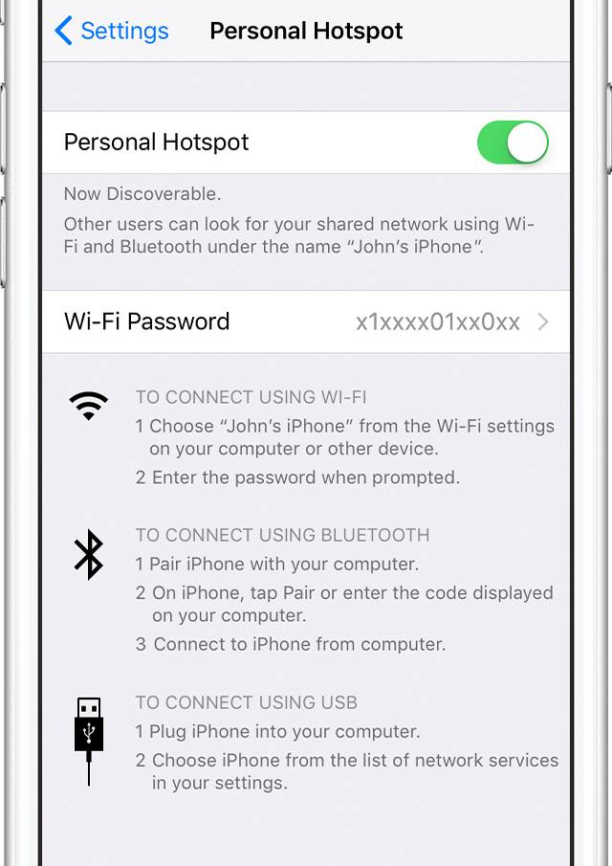
Create a personal Hotspot: iphone
Go to Settings > Cellular.
Tap Personal Hotspot, then tap the slider to turn it on.
If you don't see the option for Personal Hotspot, contact your carrier to make sure that you can use Personal Hotspot with your plan.

Slide 17
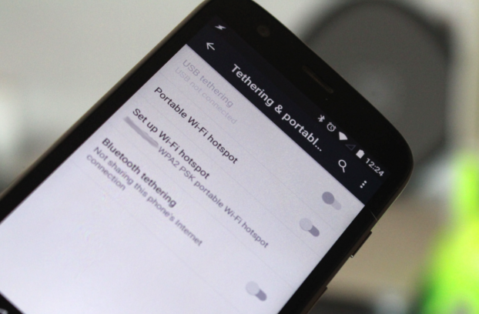
Create a WiFi Hotspot: Android
Open your main system Settings.
Hit the More button at the bottom of the Wireless & networks section, right below Data usage.
Open Tethering and portable hotspot.
Tap on Set up Wi-Fi hotspot.

Slide 18
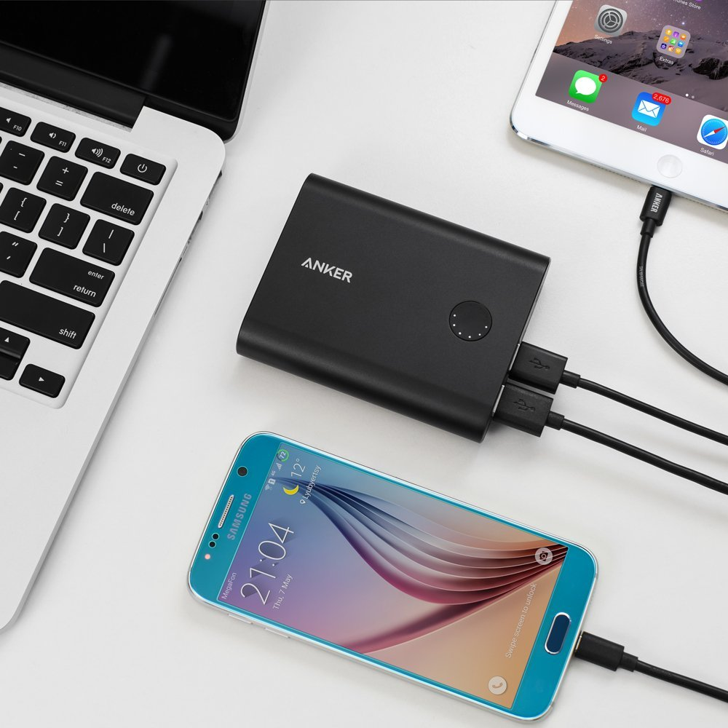
Stay Charged
With a Portable Battery Charger
Inexpensive
Universal
5V 1A = Phone Charging
5V 2A = iPad and Quick Charge Devices

Slide 19
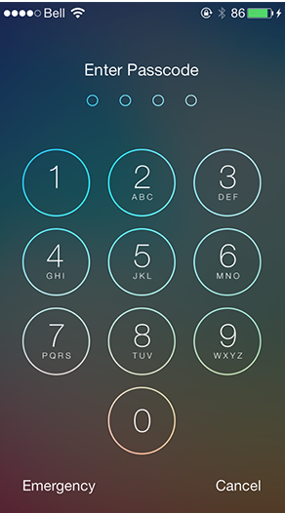
Use The Lock Screen
Set up a passcode on iPhone
Go to Settings > Touch ID & Passcode.
On devices without Touch ID, go to Settings > Passcode.
If you have an iPhone X, go to Settings > Face ID & Passcode.

Slide 20
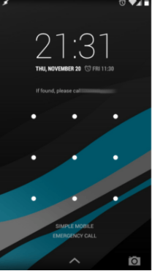
Use the lock screen
Set Pattern, PIN, or Password lock on Android
Open your device's Settings app
Tap Security & Lock Screen. (or "Security & Location" ) To pick a kind of screen lock, tap Screen lock.
Tap the screen lock option you’d like to use. Follow the on-screen instructions.
‘Show owner info on lock screen‘

Slide 21
questions

Slide 22
Thank you
Carrie L. Batalon
Certified Family Law Specialist, by the Family Law Certification Board
Mallor | Grodner LLP
Bloomington / 511 Woodscrest Drive, Bloomington, IN 47401
p 812.332.5000 / f 812.961.6161
Indianapolis / 101 W. Ohio, Ste. 1600, Indianapolis, IN 46204
p 317.453.2000 / f 317.631.1314
cbatalon@lawmg.com
www.lawmg.com
Nicholas A. Shertzer
IT Systems Administrator
Computer Consultant
NAS Technology Consulting, LLC
p 812.669.0970
@nickshertzer
www.NASTechLLC.com
Nick@NickShertzer.com

